Slide 1
Search Engine Marketing
Pay For Every Click

Slide 2
Search Engine Marketing
SEM, or search engine marketing, is the act of using paid strategies to increase search visibility
Brands pay for ads to appear as search results on search engine results pages

Slide 3
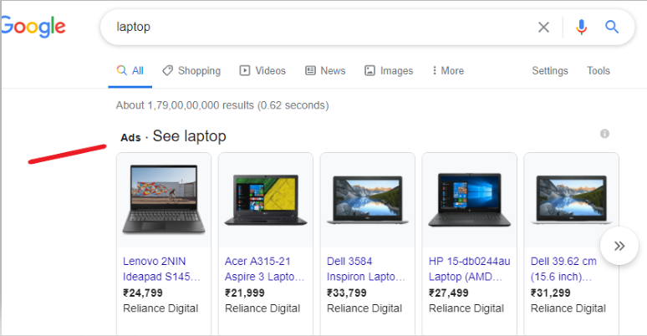
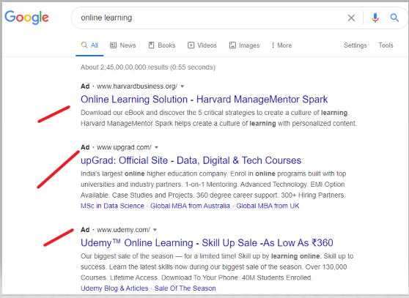
Search Engine Results Pages (SERP)
Paid search ads can be found on almost any search results page. These paid placements are typically located at the top and bottom of the page.
They include an “Ad” designation to let users know that it is a paid placement

Slide 4
Pay-Per-Click (PPC)
PPC is a paid marketing strategy where a brand creates a digital ad and is charged each time a user clicks on it. When PPC ads are shown in search results, it is considered SEM.
PPC can be used on sites that support digital ads like Promoted Tweets or Facebook Ads. PPC also includes Google display ads, where brands are charged when a user clicks on a banner ad on a website.

Slide 5
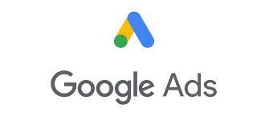

SEM Platforms

Slide 6
Types of SEM Keywords

Slide 7
Keyword | Description | Examples
Broad match | Broad match keywords are the ones that enable you to reach the widest audience possible, letting you drive a larger volume of traffic to your website. | women’s scarves and hats winter hats for women hats for stylish ladies
Phrase match | Phrase match keywords lie somewhere in between: they are more focused than broad match keywords but less so than exact ones. This does provide you with greater flexibility in terms of getting visitors to your website. | blue women’s hats buy hats for women ladies hats on sale
Exact match | Exact match keywords are the diametric opposite of broad keywords. As the name clearly states, these keywords are based on exact search queries and terms, | women’s hats ladies hats hats for women
Negative | Negative keywords are variations of broad match, phrase match, and exact match keywords that you don’t want to use in your campaign. | Hats Women

Slide 8
SEM Targeting
Location
Location targeting sets ads to only show to people who are within a certain ZIP code or geographic area.
Ad schedule
Ad schedule targeting sets ads to only show at certain times of the day or during specific days of the week
Demographic
Device
Demographic targeting sets ads to only show to people who fit certain demographic categories based on age and gender
Device targeting sets ads to only show to users on specific devices such as mobile phones, desktops, or tablets

Slide 9
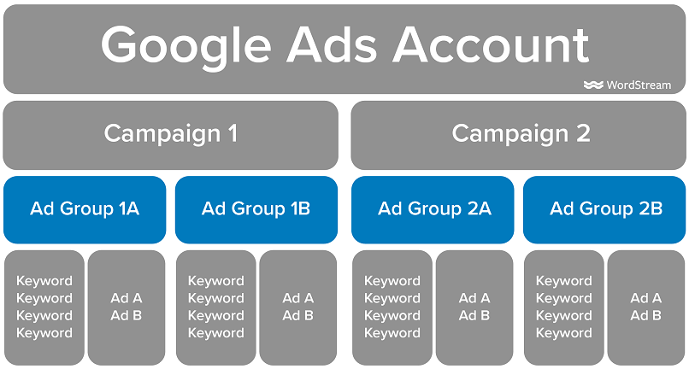
SEM Account Structure
Notes:
Image Source - https://wordstream-files-prod.s3.amazonaws.com/s3fs-public/styles/simple_image/public/images/media/images/google-ads-account-structure-03.png?3mlD1KYRNkTaGQe6e7HLYF0VLGJHRueG&itok=AF8LQBJe

Slide 10
SEM Ad Auction
Advertisers identify the keywords they want to bid on, finalize the budget and create grouping of the keywords that are paired with ads
Google then enter keyword from the account it deems most relevant into auction with maximum bid which you have associated with ad

Slide 11
How does Google determine which ad is shown where?
Google looks two important factors quality score and maximum bid
Ad Rank = Max CPC Bid * Quality Score
Ad Rank - Ad Rank determines the positions in which ads participating in the auction are shown. The better the Ad Rank, the higher the position. The best Ad Rank gets the top ad position
Max CPC Bid - Maximum bid specified for the keyword
Quality Score - Rating that the platform assigns to your ad. There is no clear formula for Quality Score, but it is believed to be based on factors such as your click-through rate (CTR), the relevance of keywords to the ad group, the relevance of landing page to keywords, and historical ad performance.

Slide 12
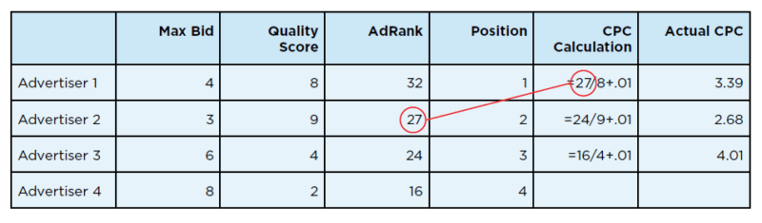
CPC Calculated
Actual cost-per-click (CPC) an advertiser pays when someone clicks on their ads
CPC = The Ad Rank of Advertiser Below / Quality Score + $0.01
In above example advertiser 2 has to pay less for ads because of better Quality Score
Notes:
Image Source - https://searchengineland.com/guide/ppc/how-the-ppc-ad-auction-works

Slide 13
References
https://www.wordstream.com/articles/what-is-google-adwords
https://searchengineland.com/guide/ppc/how-the-ppc-ad-auction-works
https://www.semrush.com/blog/keyword-match-types-for-seo-and-adwords-whats-the-difference/
https://blog.alexa.com/what-is-sem/

Slide 14

Thank You
For any queries connect me at jatinkochhar@hotmail.com

